Slide 1

Best Use of a Grant Award Entry Template
As a new requirement to the Grants program, any school that is awarded a Grant must enter their garden project into a new ‘Best Use of a Grant’ Award category within 18 months of receiving their Grant.
Entries into the ‘Best Use of a Grant’ Award category will not be judged against gardens/garden projects entered in other Award categories and are not expected to be comparable in scope and scale.
‘Best use of a Grant’ entries require only a before and after photo, along with a brief description of your garden/garden project. A simple entry template will be provided.
VSGP will be judging the ‘Best Use of a Grant’ Award only against other entries in the same category and will not be judged on the size or scope of the project, but rather what your school was able to achieve with your grant.

Slide 2
Best Use of a Grant Award
School Name and Suburb
List the Grant Category you won
& the Year you received your Grant.

Slide 3
1/ Garden Project Information
Tells us about your project.
This may include:
Who was involved in the garden project – e.g. year levels/garden club/ working bee.
How were students involved – e.g. design/planning, development/build, maintenance/up keep.
How will students/school use the garden – e.g. classes/education, recess or lunch, well-being benefits, aesthetic appearance.
Community involvement: parents, community groups, volunteers, local businesses, councils or organisations.

Slide 4
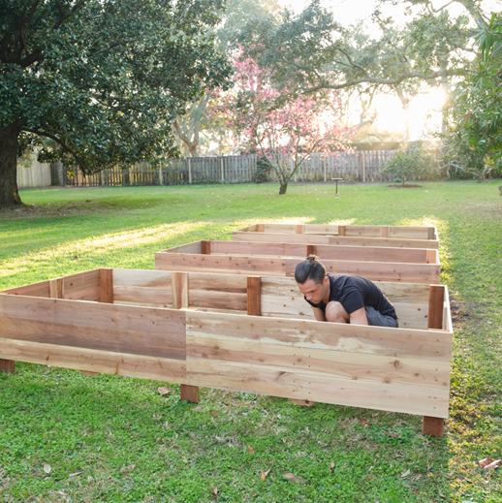
2/ Photos of the Garden Project
Photos of your school garden BEFORE the project.
Description
Description
Description
At least one before photo must be provided.

Slide 5
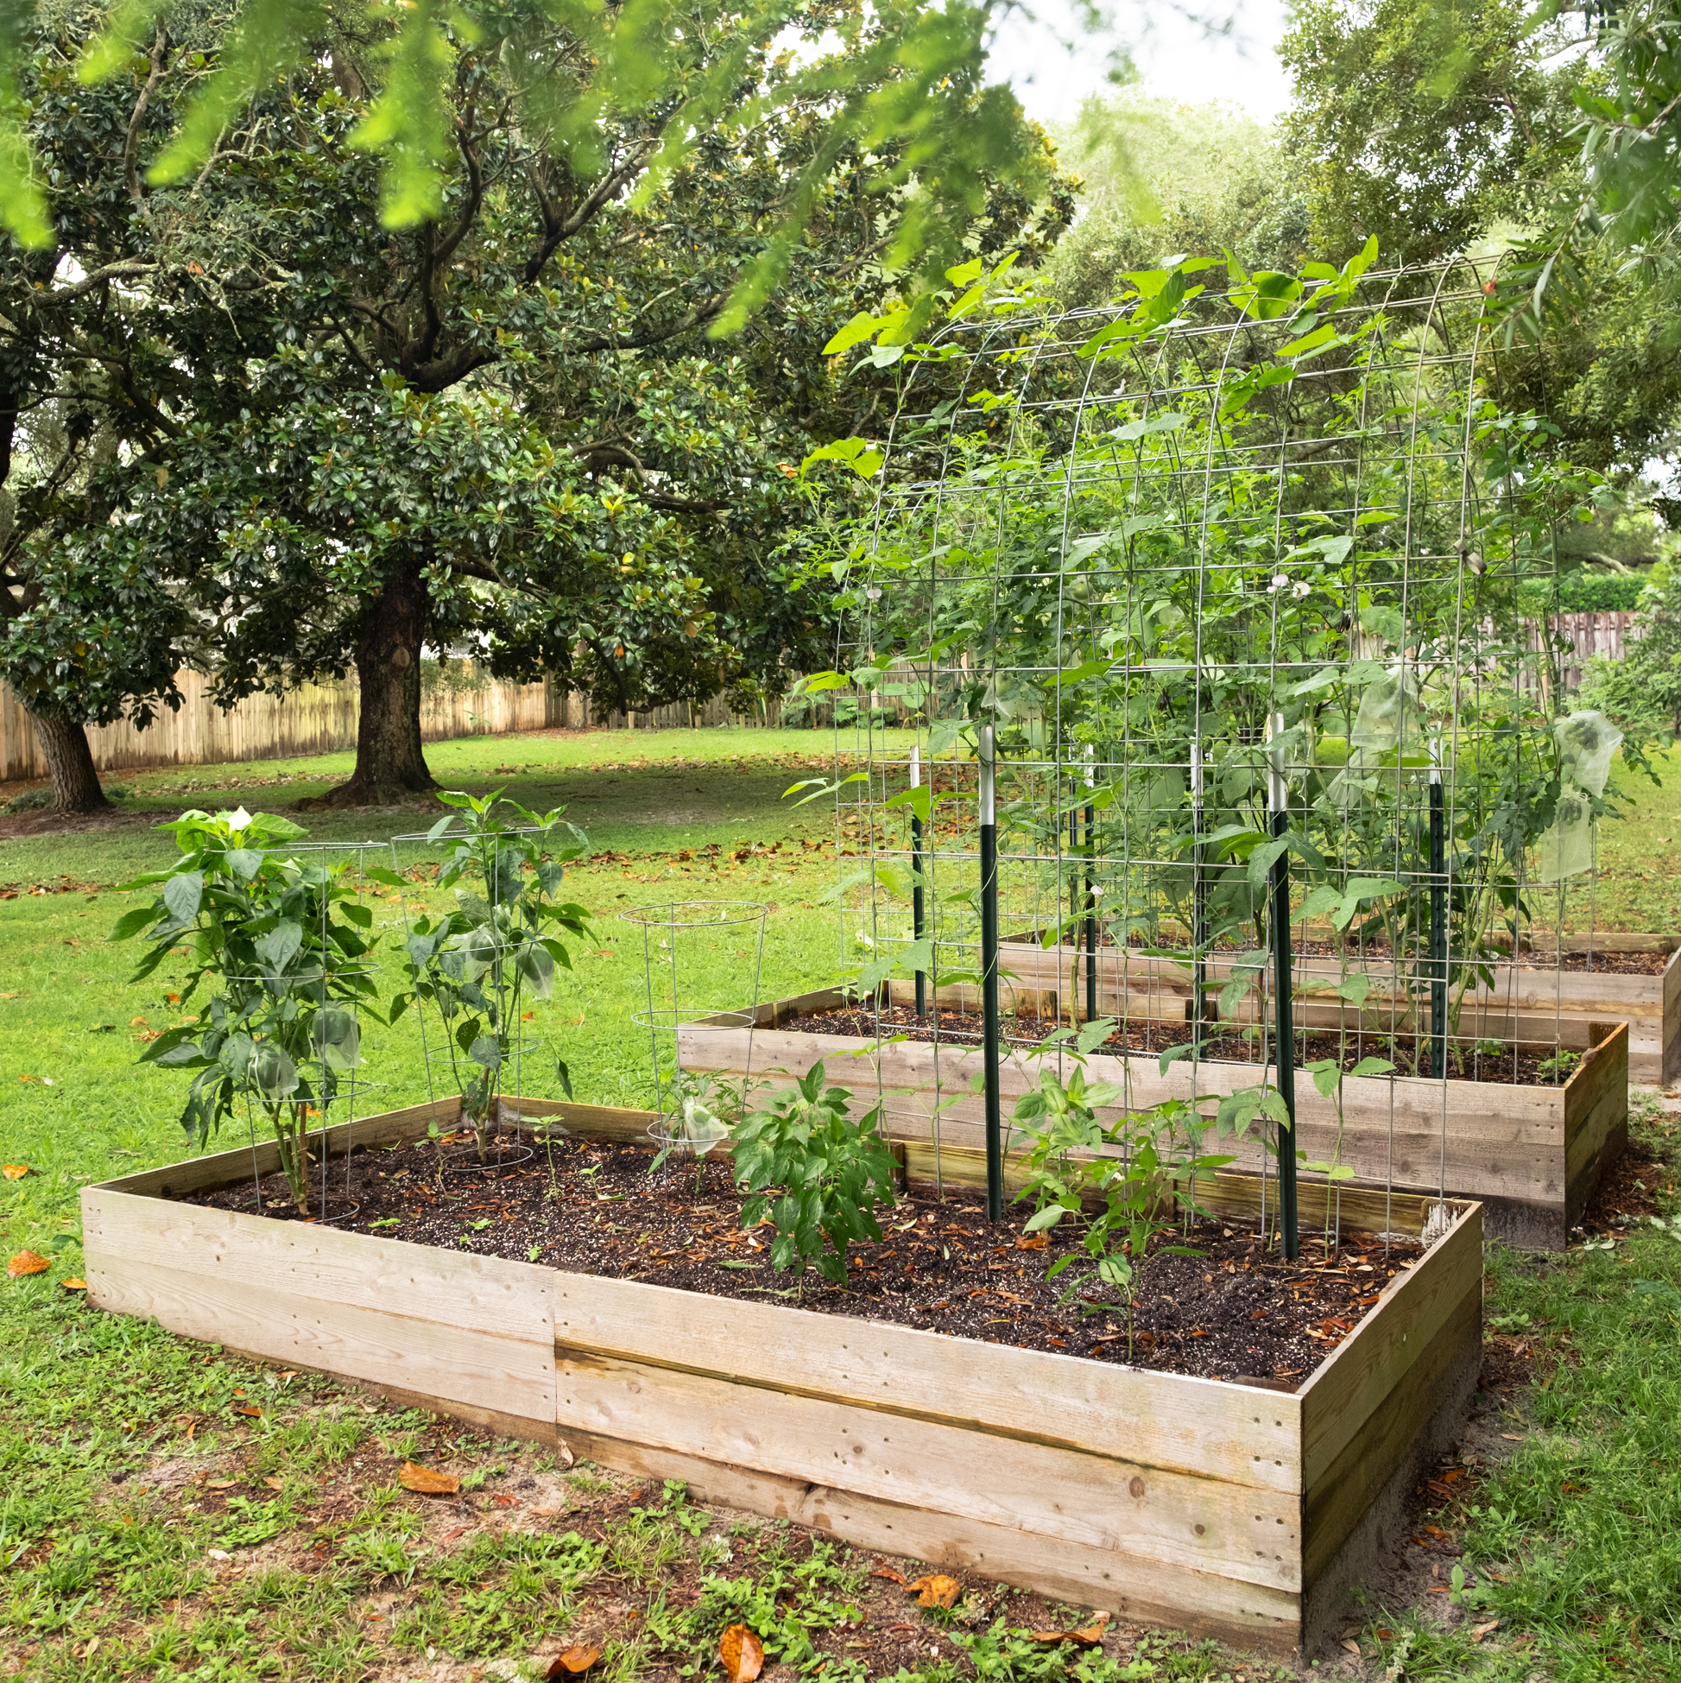
2/ Photos of the Garden Project
Photos of your school garden AFTER project just completed.
Description
Description
Description
At least one after photo must be provided.

Slide 6
2/ Photos of the Garden Project
Photos of your school garden AFTER project and garden is established.
Description
Description
Description
This is optional – if you garden has had time to grow after initial completion and Award entry time.

Slide 7
Bonus Points
Bonus points will be awarded to school gardens which:
Are sustainable – designed to protect, restore and enhance the ability of the landscape for self-sufficiency
Demonstrate use of recyclable materials in a practical and/or decorative manner
Please register your Best Use of a Grant Award entry through the Award application page and attach your presentation. We are excited to see your Grant garden project results.

