Slide 1
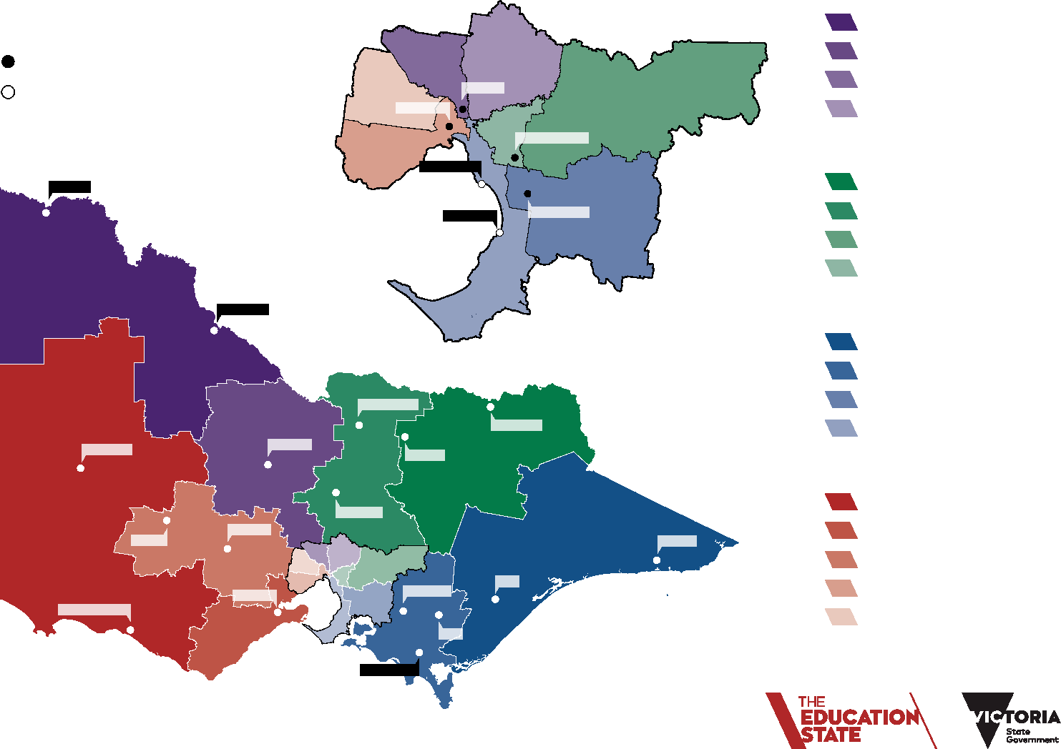
Department of Education and Training
Regions and Areas
North Western Victoria Region
Mallee
Loddon Campaspe Hume Moreland
North Eastern Melbourne
Regional Office Sub-regional Office
Footscray
Coburg
Glen Waverley
North Eastern Victoria Region Ovens Murray
Goulburn
Outer Eastern Melbourne Inner Eastern Melbourne
South Eastern Victoria Region Outer Gippsland
Inner Gippsland
Southern Melbourne Bayside Penninsula
Cheltenham
Mildura
Frankston
Dandenong
Swan Hill
Shepparton
Bendigo
Horsham
Seymour
Wodonga
Ballarat
Benalla
South Western Victoria Region Western District
Barwon
Ararat
Orbost
Central Highlands Western Melbourne Brimbank Melton
Geelong
Warragul
Sale
Warrnambool
Moe
Leongatha

